Slide 1

Retrieval & OPTIMIZATION TECHNIQUES in A RAG
CREATED BY :
Gaurav Kumar
Avinash ravikumar
Sushmita singh

Slide 2
PRE-REQUISITES FOR THE TRAINING
Launch any IDE (Jupyter Lab or VS Code) With Python>= 3.12.
Use Venv for running the Hands-On code
Install Below Libraries by running below pip install command-
Create your own Cohere key using personal email for exiting the use-cases. Link: Cohere Link
%pip install cohere sentence_transformers

Slide 3
AGENDA
Different Retrieval and Optimization Techniques in RAG
Hybrid Search Technique – Deep Dive
Re-Ranking Technique – Deep Dive
Reinforcement Learning with Human Feedback – Conceptual
Q & A

Slide 4






Gen ai – Optimizing techniques (RAG)
Retrieval Techniques
Optimization Techniques
Hybrid Search Technique
Keyword-based search + Vector-based semantic search → exact matches and contextual relevance
Vector Embeddings + NLP → relevant and accurate results
Real-time Indexing and Adaptive learning. Multimedia content and Content Analysis
Example: Purchasing “Sneakers/Shoe”
in an E-commerce site
Re-Ranking Technique
AI models refine and order the results of the outputs for most relevant and high-quality results
Uses ML Models and Encoders to get the most accurate results
Example: Selecting your favorite series from Netflix. Ex: Get me a Sci-Fi based series
Products retrieved based
on keyword search
and re-ranker helps in
retrieving the missing relevant chunks
Reinforcement Learning Human Feedback
Feedback mechanism → performance of the Gen model informs and adjusts the retrieval process, leading to continuous improvement.
Example: Amazon Service chat → Agent behind the chatbot
learns based on
User interactions
and updates the
results retrieved every time.

Slide 5
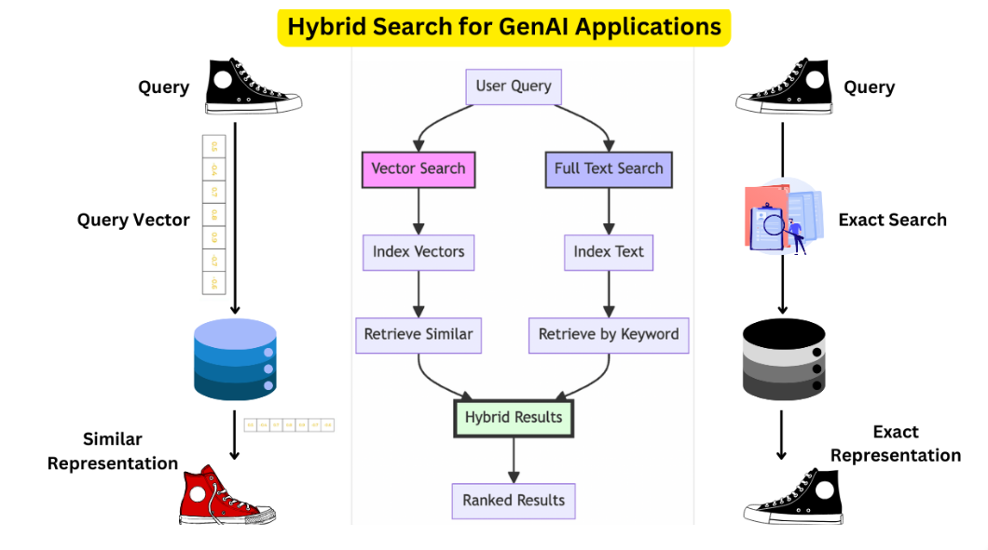

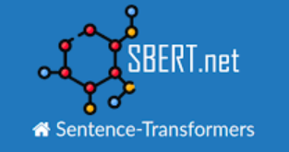


Gen ai – Hybrid search
Hybrid search is a combination of full text and vector queries that execute against a search index that contains both searchable plain text content and generated embeddings
Keyword and Semantic Search
Combines traditional keyword-based search with semantic search, which understands the context and meaning behind the words..
Structured and Unstructured Data Search
Searches across both structured data (databases, spreadsheets) and unstructured data (documents, emails).
Database and Full-Text Search
Integrates database queries with full-text search capabilities to retrieve relevant documents and data entries.
Local and Cloud Search
Searches across both local storage and cloud-based data repositories.
Supported Python Libraries
Supported Python Libraries
Image and Text Search: Combines image recognition with text search to find relevant results.

Slide 6
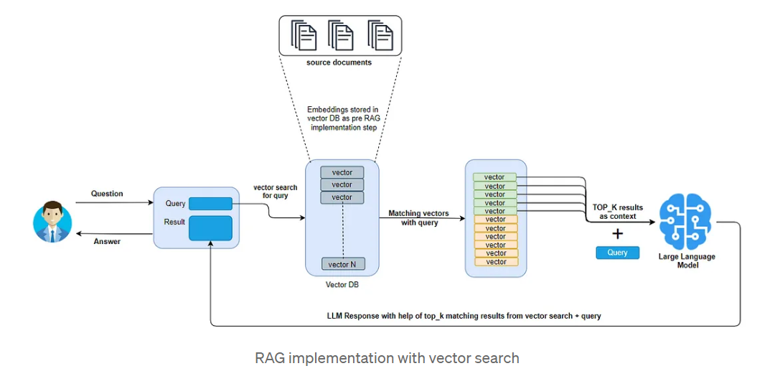
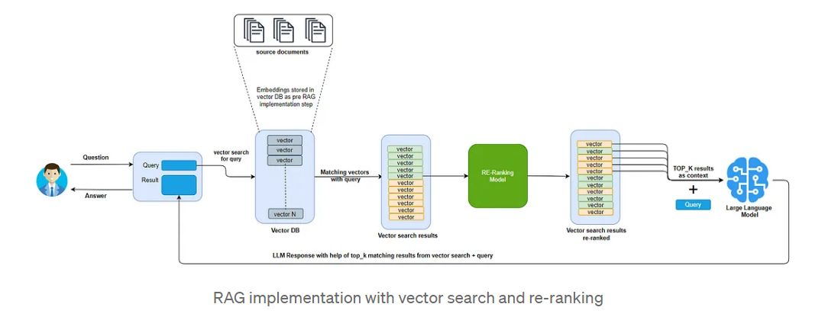
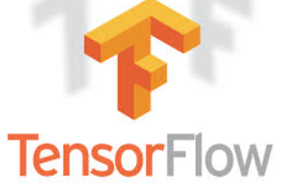

Gen ai – RERANKER MECHANISM
Features Extracted:
Content based
User Interaction based
Metadata based
Insights:
Vector Search is fast compared to Re-ranker in retrieving results
Re-ranker re-orders the results based on features extracted by creating a matching score
LLM limitation
LLM Context Limitation: There is a limit for feeding data into LLM known as “context window”
LLM Recall Performance: Too many tokens degrade the LLM recall performance. Decrease in relevancy of final results
Supported Python Libraries

Slide 7
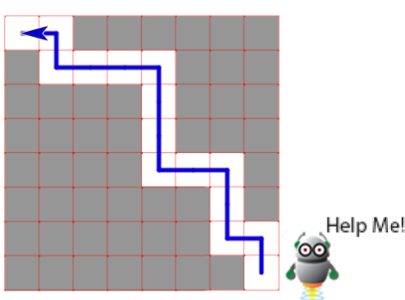
Gen ai – REINFORCMENT LEARNING Human feedback
Reinforcement learning:
Reinforcement learning is the training of ML models to make a sequence of decisions. The agent learns to achieve a goal in an uncertain, potentially complex environment.
It also combines the power of human guidance with machine learning algorithms. It involves training an AI agent to make decisions by receiving feedback. Example: Robot trying to find a way to complete a maze
Pretraining a Large Language Model (LLM):
The first step is to teach a language model by showing it tons of text. LLM Model is pretrained by
Data Collection, Data Preprocessing, Model Architecture, Evaluation and Fine-Tuning processes
Training a Reward Model:
Adjusting an existing language models to creating entirely new ones using data about what people prefer. Model gives a single score indicating how much people would prefer it.
Fine-tuning the LM with reinforcement learning:
Fine-tuning means tweaking the language model’s settings using reinforcement learning, using algorithms like Proximal Policy Optimization (PPO). This step fine-tunes the model’s results based on the evaluations from the reward model, with the goal of making the text it generates match up better with what people would like.

Slide 8
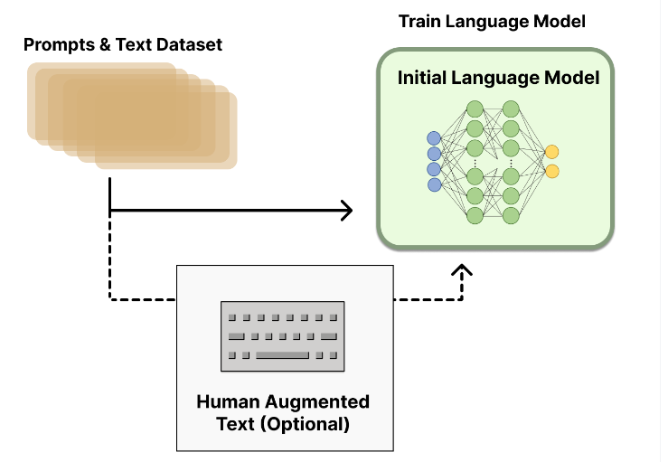
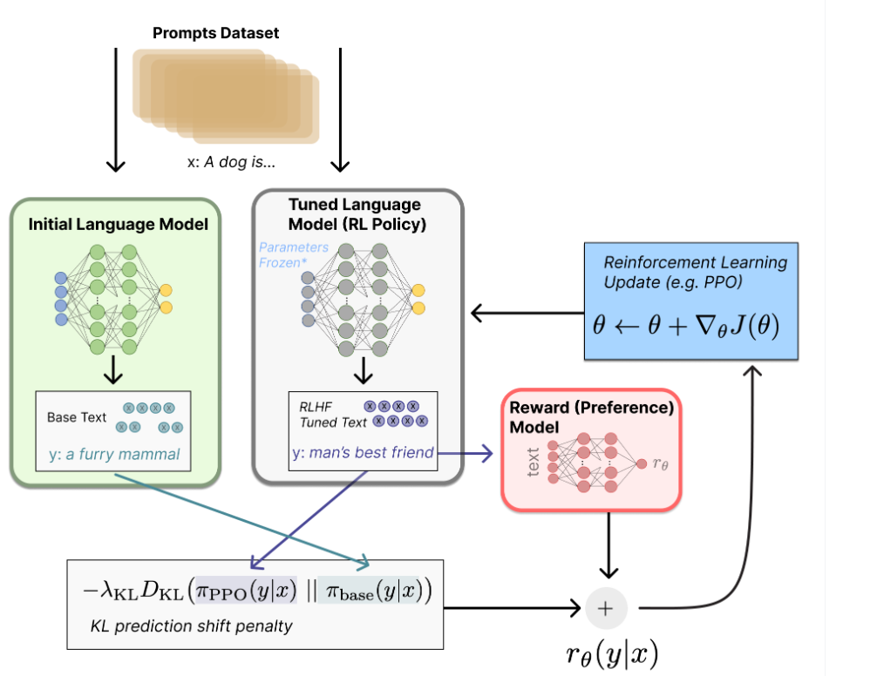
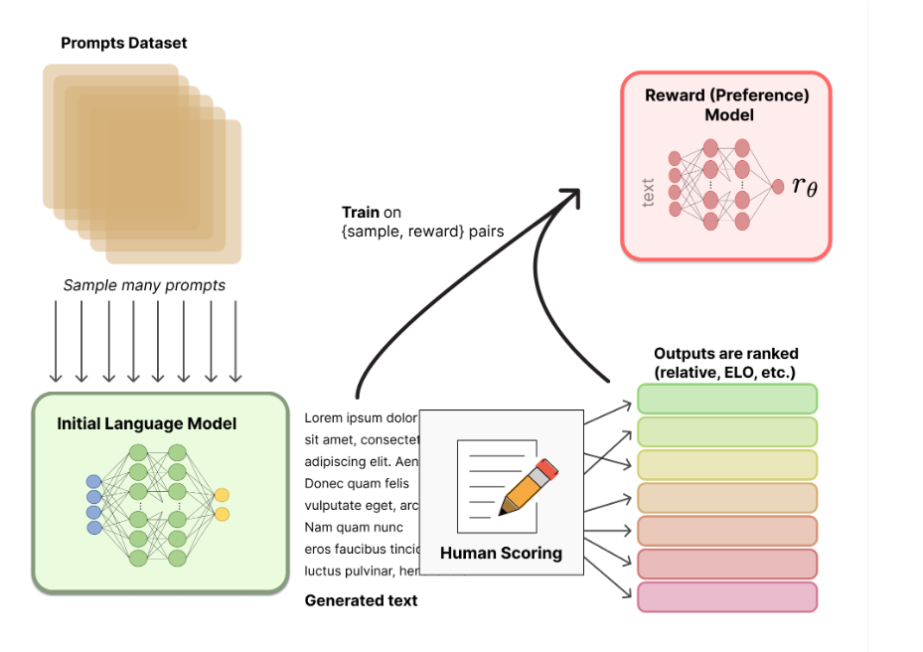
Gen ai – REINFORCMENT LEARNING Human feedback
1
Introducing Rewarding model to the traditional LLM Model to improve Human Feedback
2
Rewarding Model along with Fine Tuned LM model based on Reinforcement Learning Policy to improve desired results
1
2

Slide 9
Q & A

Slide 10




Thank you
Gaurav Kumar
DC Manager
Avinash Ravikumar
DC Sr. Consultant
Sushmita Singh
DC Sr. Consultant

